Slide 1



University Analysis: Power bi and EDA Key Questions
Explore crucial insights about universities across the globe through data analysis.
by Rishi Kumar

Slide 2



Slide 3
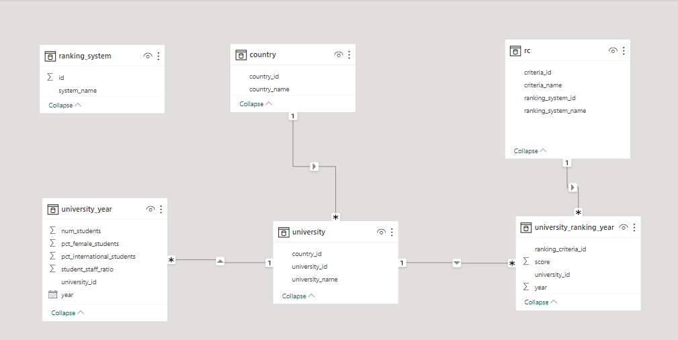
ER Model in Power Bi

Slide 4
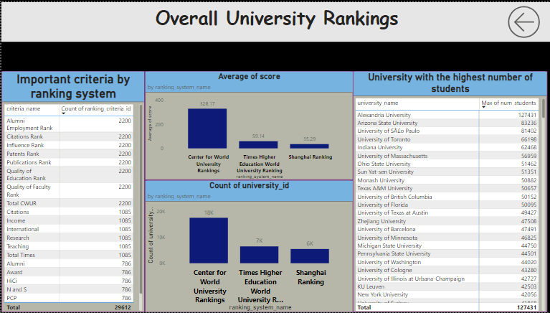

Slide 5
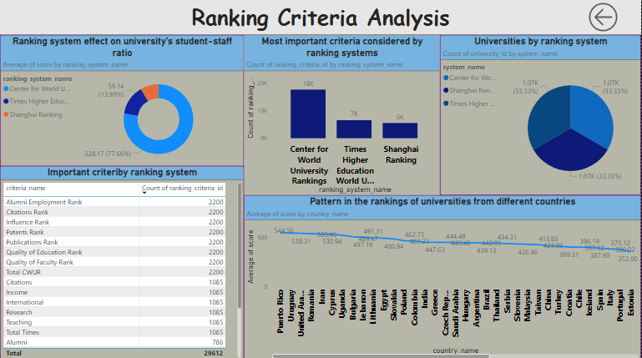

Slide 6
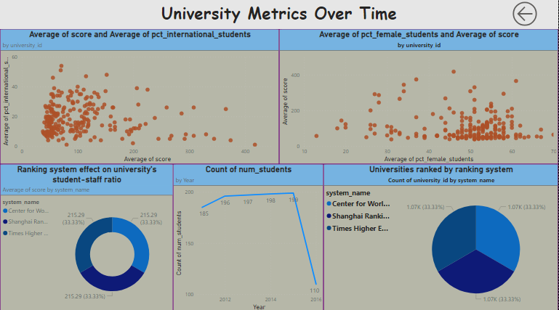

Slide 7
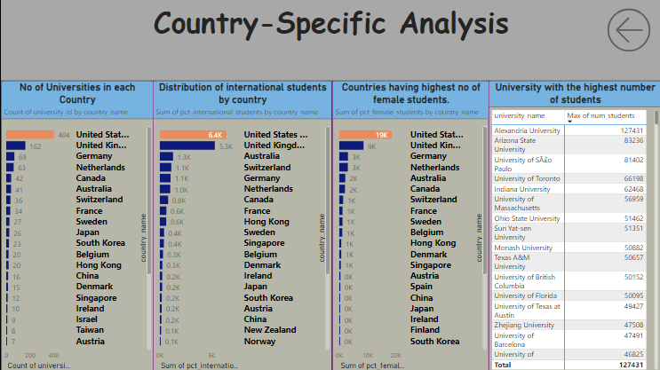

Slide 8
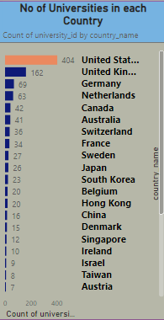
How many universities are there in each country?
Count the universities by each country.
USA has the highest no of universities amongst all .

Slide 9

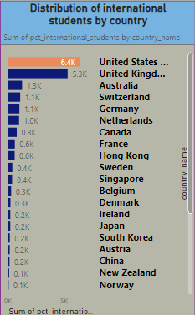
What is the distribution of international students across different countries?
Distribution of international students by country.
USA has the highest and EGYPT has the lowest numbers of international students.

Slide 10

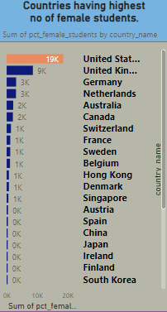
Which country has the highest number of female students enrolled in universities?
Calculate the total number of female students in each country.
USA has the highest count of female students.

Slide 11
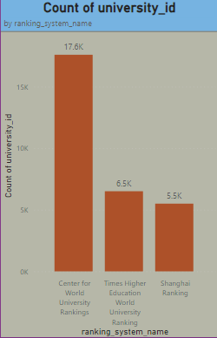
How many universities are ranked by each ranking system?
Count the universities ranked by each ranking system.
Centre for World University ranking systems cover the most institutions.

Slide 12
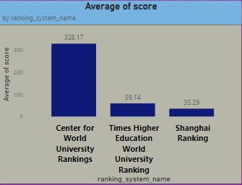
What is the average score for universities according to
each ranking system?
This can reveal which system tends to assign higher scores.
The Center for World University Rankings has the highest average score.

Slide 13
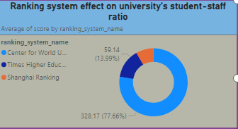
How does the ranking system affect a university's student-staff ratio?
Analyzing the relationship between ranking system scores and student-staff
ratios, the higher-ranked universities tend to have higher ratios.

Slide 14
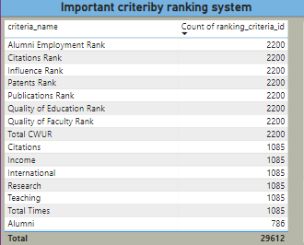

What are the most important criteria considered by ranking systems?
The key criteria used by ranking systems were identified.
Factors such as Alumni Employment, Citations Rank, and Influence Rank are top 3.

Slide 15
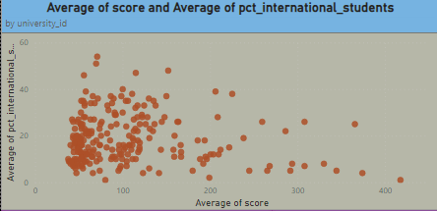
Is there a correlation between a university's score and the no of international students?
Create a scatter plot with university scores on the x-axis and the number of international students on the y-axis.
The correlation coefficient between the two variables is 0.63, which is considered to be a strong correlation. This means that there is a strong positive relationship between a university's score and the number of international students

Slide 16
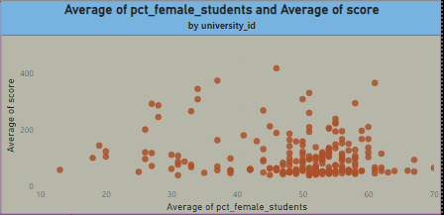
How does the percentage of female students impact a
university's ranking?
Universities with a higher percentage of female
students tend to have different ranking scores

Slide 17
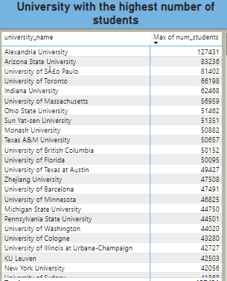
Which university has the highest number of students??
Alexandria university with the highest student enrollment
Followed by Arizona state university.

Slide 18
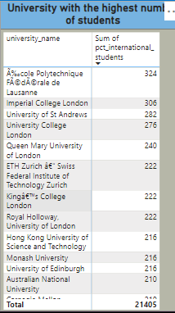
How does the percentage of international students vary
across different universities?
École Polytechnique Fédérale de Lausanne (EPFL),
Imperial College London, Constructor University, Near East University,
These universities are all outliers because they have a much higher percentage of
international students than the average university.

Slide 19
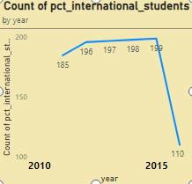
How does the percentage of international students vary
across different years?
Observing changes in the percentage of international students across
2011 to 2016, there has been a downfall trend from 185% to 110%.

Slide 20
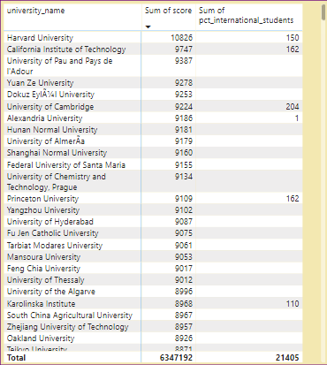
What is the impact of university's ranking on the no of international students it attracts?
The higher-ranked universities tends to attract more
international students.

Slide 21
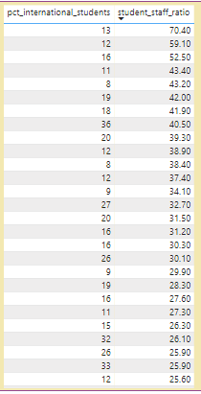
How does the percentage of international students affect a university's student-staff ratio?
There is a weak negative correlation between the percentage of international
students and the student-staff ratio. This means that universities with a
higher percentage of international students tend to have a lower student-staff ratio.

Slide 22
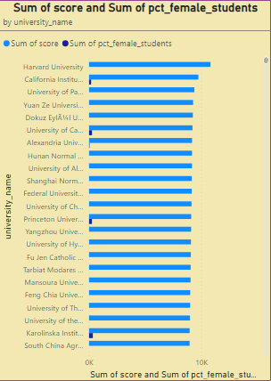
Is there a relationship between a university's ranking score and the percentage of female students enrolled?
Analyzing whether the correlation between ranking scores and student-staff
ratios changes over time but it does not changed.

Slide 23
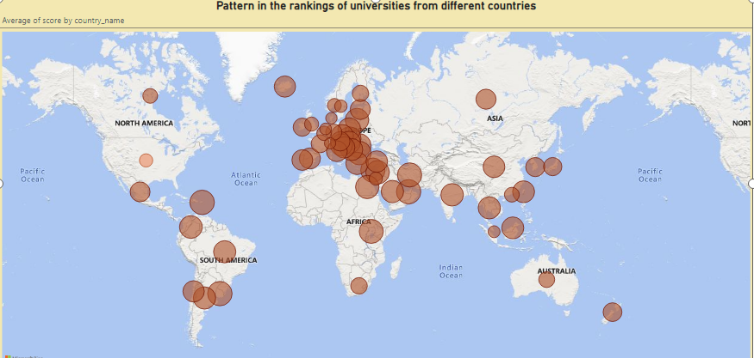
Are there any significant trends or patterns in the rankings of universities from different countries?
Exploring trends and patterns in the rankings of universities by country to identify
any notable trends or changes over time.
The United States has the highest average score, followed by the United Kingdom,
Switzerland, and Sweden.

Slide 24
Is there a correlation between a university's ranking and its student-staff ratio over years?
Analyze whether the correlation between ranking scores and student-staff
ratios changes over time.

Slide 25
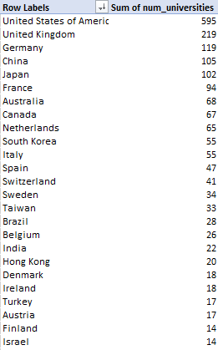
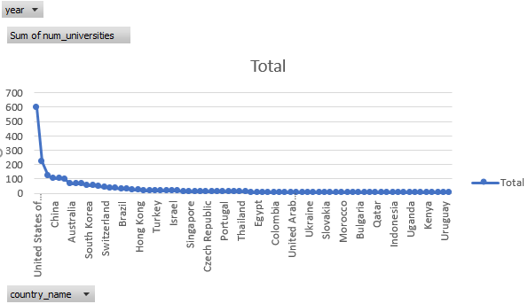
What is the distribution of university rankings?
The distribution of university rankings to understand their spread and concentration.

Slide 26
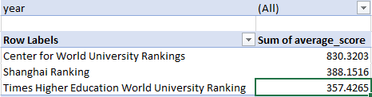
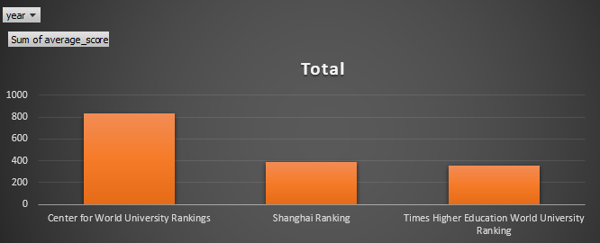
What is the trend in university rankings over time?
The trend in university rankings over time, is that they have been increasing in recent years.

Slide 27
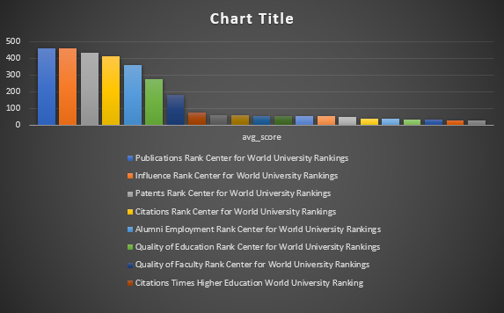
Is there a correlation between a university's ranking and its student-staff ratio over years?
Yes, there are some criteria that have different
weights in different university
ranking systems. For example, the Shanghai
Ranking places a heavy emphasis
on research, while the Times Higher Education
World University Ranking places a greater
emphasis on teaching.

Slide 28
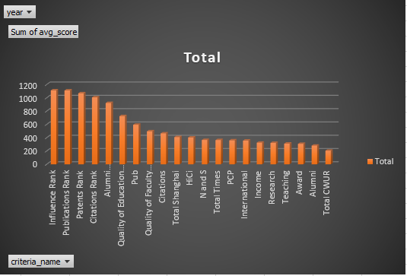
How have the weights of ranking criteria changed over time?
The Shanghai Ranking placed a heavy emphasis on research output,
Times Higher Education World University Ranking has placed a greater emphasis on
teaching quality over time, while decreasing the weight of research output.
The CWUR falls somewhere in between the
Shanghai Ranking and the THE in terms of its
emphasis on research and teaching.

Slide 29
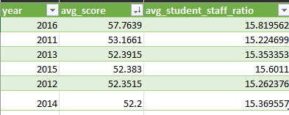
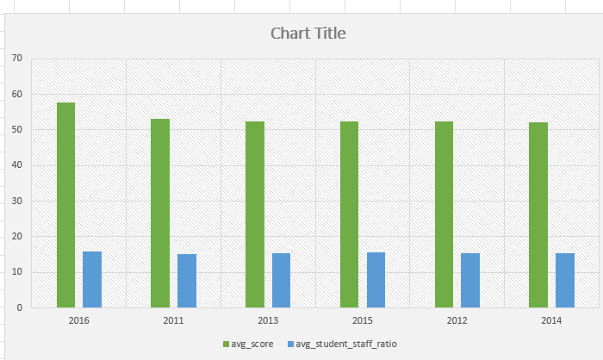
Is there a relationship between a
university’s score and the student
staff ratio?

Slide 30
Are there any common criteria used by different ranking systems?
All three ranking systems use different criteria.
Analyze whether the correlation between ranking scores and student-staff
ratios changes over time.

Slide 31
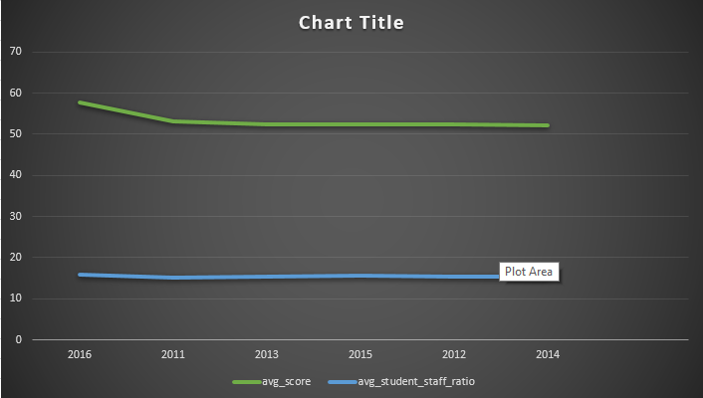
Is there a correlation between a university's ranking and its student-staff ratio over years?
There is no clear relationship between university’s ranking score and the student-staff ratio from the chart. The correlation coefficient between the two variables is only 0.03, which is very low.
Analyze whether the correlation between ranking scores and student-staff
ratios changes over time.

Slide 32
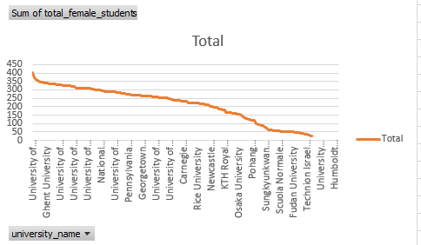
How does the number of female students differ among universities?
The top 5 universities with the highest number of female students are:
University of Vienna
King's College London
Utrecht University
Leiden University
Karolinska Institute

Slide 33
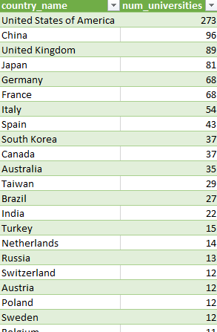
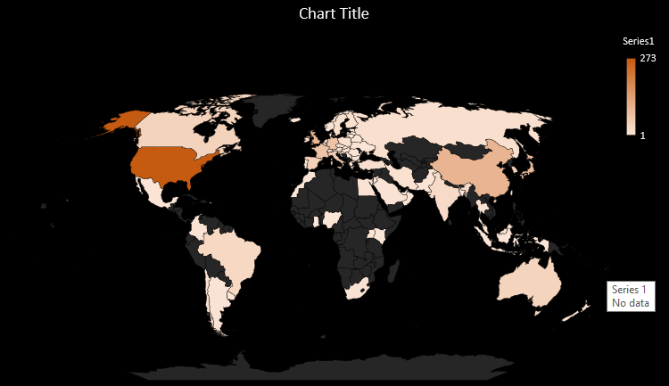
What is the distribution of universities across different countries?

Slide 34
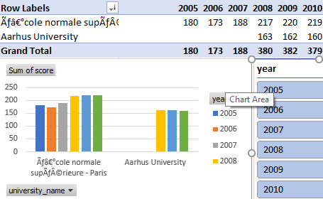
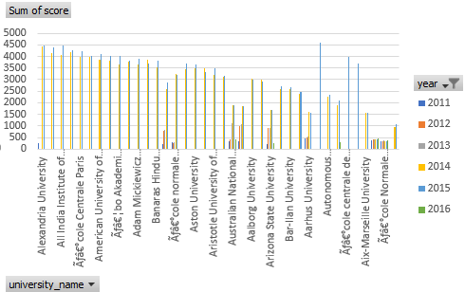
How has the ranking of universities changed over the years?
Since 2005 till 2010 only 2 universities were ranked
And from year 2011 till 2016 the number of universities ranked increased from 2 to 38
.

Slide 35
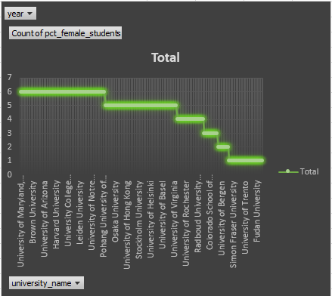
What is the trend in the percentage of female students over time?
The trend in the percentage of female students over time is increasing. According to the image you provided, the percentage of female students enrolled in higher education worldwide has increased.

Slide 36
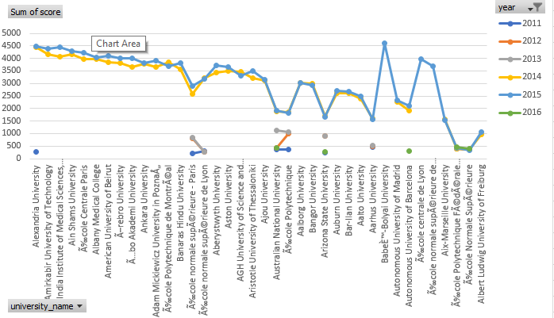
How has the ranking score of universities evolved over the years?

